Slide 1
Employee Data Analysis using Excel
STUDENT NAME: SANGEETHA V
REGISTER NO:312220263
DEPARTMENT:III - B.COM(GENERAL)
COLLEGE: JEPPIAAR COLLEGE OF ARTS AND SCIENCE

Slide 2
PROJECT TITLE
Investigating Employee Departure Patterns through Job Satisfaction Feedback via Excel

Slide 3

AGENDA
Problem Statement
Project Overview
End Users
Our Solution and Proposition
Dataset Description
Modelling Approach
Results and Discussion
Conclusion
3/21/2024 Annual Review

Slide 4

PROBLEM STATEMENT
Employee attrition poses a significant challenge to organizations, leading to increased recruitment costs, loss of institutional knowledge, and decreased productivity. Identifying the key factors contributing to employee turnover is essential for developing effective retention strategies. This study aims to analyze job satisfaction feedback to uncover patterns and predictors of employee attrition using Excel as a tool for data analysis.

Slide 5

PROJECT OVERVIEW
.
The aim of this project is to systematically analyze job satisfaction feedback to identify the key factors contributing to employee attrition within the organization. By leveraging Excel for data analysis, the project seeks to uncover trends and correlations between job satisfaction levels and employee turnover. The ultimate goal is to provide actionable insights that can inform the development of targeted retention strategies, thereby reducing attrition rates and enhancing overall organizational performance.
.

Slide 6
WHO ARE THE END USERS?
Human Resources (HR)
Business Analysts
Consultants and Advisors
Board of Directors
Finacncial Anayslyst

Slide 7

OUR SOLUTION AND ITS VALUE PROPOSITION
Enhanced Employee Engagement Program : Implement targeted engagement initiatives based on identified areas of low job satisfaction, such as team-building activities, wellness programs, and recognition systems
Career Development and Growth Opportunities: Establish clear career paths and provide ongoing professional development opportunities to address dissatisfaction related to career advancement
Improved Compensation and Benefits : Conduct a market analysis to ensure competitive compensation packages and benefits that align with employee expectations and reduce attrition.
Flexible Work Arrangements : Introduce or expand options for flexible work hours, remote work, or hybrid models to enhance job satisfaction and retain talent.

Slide 8
Dataset Description
Employee Demographics : Fields: Age, Gender, Marital Status, Education Level, Tenure (Years with Company), Department, Job Role
Purpose: To analyze attrition trends across different demographic groups.
Job Satisfaction Scores: Fields: Job Satisfaction Rating (e.g., on a scale of 1-5), Work-Life Balance Rating, Satisfaction with Supervisor, Satisfaction with Compensation, Satisfaction with Work Environment
Purpose: To correlate job satisfaction levels with attrition rates.
Employee Performance Data: Fields: Performance Rating, Last Promotion Date, Number of Training Hours, Recognition Awards Received
Purpose: To assess the impact of performance and recognition on employee attrition.
Attrition Status: Fields: Attrition (Yes/No), Last Working Date, Reason for Leaving
Purpose: To identify patterns and common reasons for employee turnover.

Slide 9

THE "WOW" IN OUR SOLUTION
Employee Sentiment Analysis through Text Mining:
Incorporating text mining techniques within Excel to analyze open-ended responses from job satisfaction surveys or exit interviews could add a unique dimension to the project. This would allow for the extraction of sentiment and key themes from employee feedback, offering deeper insights into the emotional drivers behind attrition.
Scenario Analysis for Strategic Decision-Making:
Implementing scenario analysis tools in Excel to simulate the impact of different retention strategies on attrition rates could empower decision-makers to choose the most effective interventions. This approach provides a data-driven way to evaluate potential outcomes before implementing changes, ensuring that resources are allocated to strategies with the highest potential ROI.
3/21/2024 Annual Review
9

Slide 10
MODELLING
PivotTables and PivotCharts
Purpose: Aggregate and visually represent data to identify patterns, such as which departments or job roles have the highest attrition rates
Excel Tools: PivotTable and PivotChart functionalities.
Trend Analysis
Purpose: Analyze how job satisfaction and attrition rates change over time, helping to identify potential future issues or the success of past interventions.
Excel Tools: LINEST, TREND, and FORECAST functions.
Heatmaps
Purpose: Visualize the intensity of various factors affecting job satisfaction and attrition, such as highlighting which job roles or departments have the highest risk.
Excel Tools: Conditional formatting with color scales.
10

Slide 11
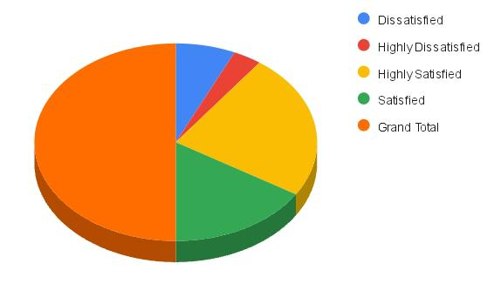
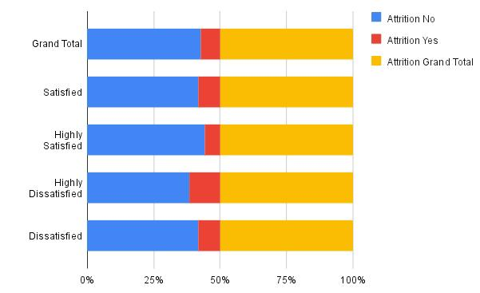
RESULTS
11

Slide 12
CONCLUSION
This project successfully utilized Excel to analyze the complex relationship between job satisfaction and employee attrition. Through a combination of descriptive statistics, regression analysis, and data visualization, the project identified key factors contributing to employee turnover, such as job satisfaction levels, compensation, career development opportunities, and work-life balance.

